Slide 1
Introduction
SharePoint Information Architecture
Notes:
Instructors notice:
Poll in your classroom if the students are familiar with SharePoint already. If they are, they likely already know about lists, fields, content types and such and you can safely skip this lesson. If you have a class with developers not having worked with SharePoint before, take them through this lesson to teach them about the basics of SharePoint.

Slide 3
How to View This Presentation
To switch to Notes Page view:
On the ribbon, click the View tab, and then click Notes Page
To navigate through notes, use the Page Up and Page Down keys
Zoom in or zoom out, if required
In the Notes Page view, you can:
Read any supporting text—now or after the delivery
Add notes to your copy of the presentation, if required
Take the presentation files home with you

Slide 4
Overview
In this Lesson
Information architecture concepts
Working with Field Types
Working with Site Columns and List Columns
Working with Content Types
Working with Taxonomy

Slide 5
Objectives
Learn about what components are available to develop an information architecture
Learn how to provision these components declaratively and programmatically

Slide 6
Information architecture concepts
Defining information architecture
“Information architecture (IA) is the structural design of shared information environments; the art and science of organizing and labelling websites, intranets, online communities and software to support usability and findability; and an emerging community of practice focused on bringing principles of design and architecture to the digital landscape. Typically, it involves a model or concept of information that is used and applied to activities which require explicit details of complex information systems.”
Source: https://en.wikipedia.org/wiki/Information_architecture

Slide 7
Information architecture concepts
Developing an information architecture on SharePoint
SharePoint is a platform built for various types of stuctured and unstructured data
Examples of structured data are:
Tasks, Calendars, User Profiles, External data
Examples of unstructured data are:
Documents, Pages, Images, Video
Unstructured data can be made into structured, or semi-structured data by applying metadata

Slide 8
Working with Field Types
Field Types are lowest level of storage definition leverage in SharePoint
They define how to store data types in a content database
They also define how to render the UI to display and edit data
Examples of Field Types:
Text, Number, DateTime, Choice, Lookup, User
These are defined in C:\Program Files\Common Files\microsoft shared\Web Server Extensions\16\TEMPLATE\XML\FLDTYPES.XML
Although it is possible to build custom Field Types, it is not recommended

Slide 9
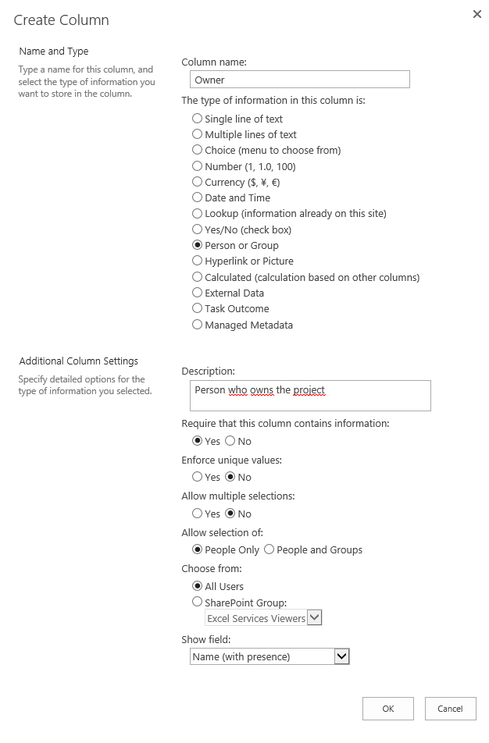
Working with Field Types
When adding a Column (Field), configure it to use one of the installed Field Types
The Field Type can also be configured for a specific purpose for a specific column
<Elements xmlns="http://schemas.microsoft.com/sharepoint/">
<Field
ID="{0e9967c7-0eaf-4316-b5d7-6ba6f917a95d}"
Name="ProjectOwner"
Description="Person who owns the project"
DisplayName="Project Owner"
Required="True"
Group="Contoso"
AllowDuplicateValues="TRUE"
EnforceUniqueValues="FALSE"
Type="User"
List="UserInfo"
ShowField="ImnName"
UserSelectionMode="PeopleOnly"
UserSelectionScope="0" />
</Elements>
Column settings
Field Type
Field Type settings

Slide 10
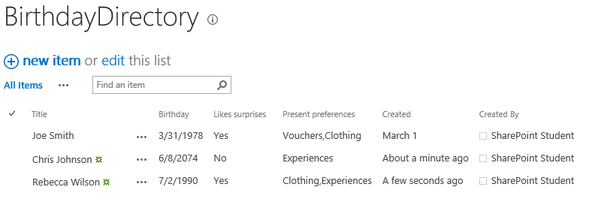
Working with Site Columns and List Columns
Every list or library in SharePoint has columns
Some are built-in, mandatory columns:
ID (Number)
CreatedBy (User)
ModifiedBy (User)
Created (DateTime)
Modified (DateTime)
Columns can be used to support the information architecture
Built-in
Custom
Built-in

Slide 11
Working with Site Columns and List Columns
Columns can be defined declaratively or programmatically
For more information about the attributes see the Field Schema page on MSDN*
One way to see a field’s xml is to configure the column using the UI, then use REST to get the XML**
<Elements xmlns="http://schemas.microsoft.com/sharepoint/">
<Field
ID="{0e9967c7-0eaf-4316-b5d7-6ba6f917a95d}"
Name="ProjectOwner"
Description="Person who owns the project"
DisplayName="Project Owner"
Required="True"
Group="Contoso"
AllowDuplicateValues="TRUE"
EnforceUniqueValues="FALSE"
Type="User"
List="UserInfo"
ShowField="ImnName"
UserSelectionMode="PeopleOnly"
UserSelectionScope="0" />
</Elements>
* https://docs.microsoft.com/en-us/sharepoint/dev/schema/field-element-field ** https://dev.contoso.local/_api/Web/AvailableFields?$select=SchemaXml&$filter=Title eq ’<title>’
Notes:
https://docs.microsoft.com/en-us/sharepoint/dev/schema/field-element-field
https://dev.contoso.local/_api/Web/AvailableFields(guid’<fieldID>')?$select=SchemaXml <= the challenge with this method is that if you configure the column via the UI, then you will not have the FieldId available. You can obtain this through the URL, though.

Slide 12
Working with Site Columns and List Columns
List Columns
Columns can be added to a list in three different ways:
Directly to the list or library (not reusable)
By associating a Site Column with the list or library (reusable)
Through a Content Type associated with a list of library (reusable)
List columns can be added declaratively through a List Definition
List columns can be added programmatically in several ways

Slide 13
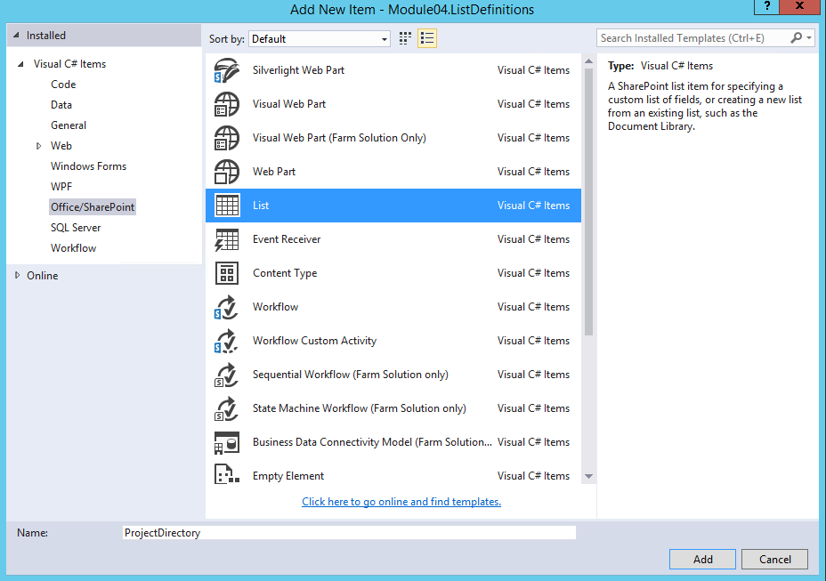
Working with Site Columns and List Columns
List Definition
Visual Studio
Add New Item
Choose List
Provide a Name
Click Add

Slide 14
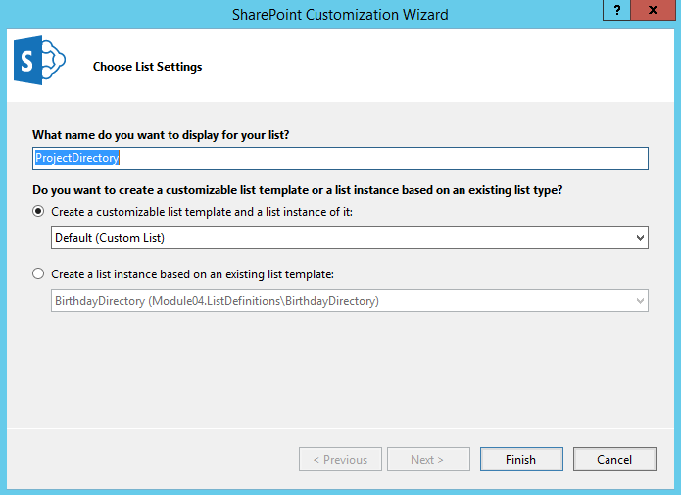
Working with Site Columns and List Columns
List Definition
List Wizard
Provide a Name
Choose to create a customizable template and an instance of the list
Click Finish

Slide 15
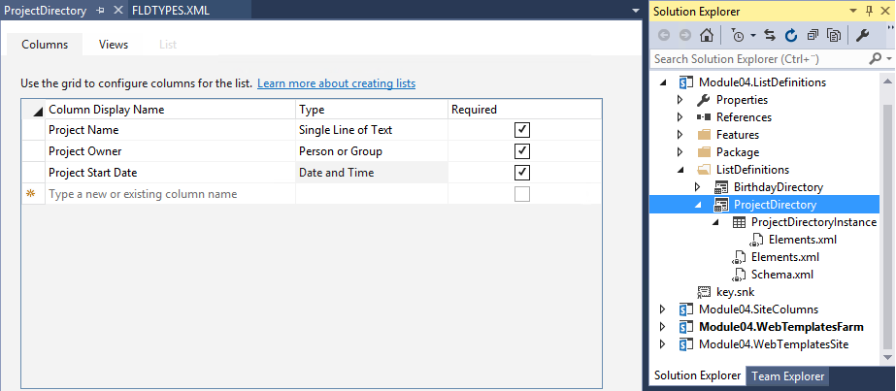
Working with Site Columns and List Columns
List Definition
List Designer
Define which columns to associate with your list template

Slide 16
Working with Site Columns and List Columns
List Definition XML
<List xmlns:ows="Microsoft SharePoint" Title="ProjectDirectory" FolderCreation="FALSE" Direction="$Resources:Direction;" Url="Lists/ProjectDirectory" BaseType="0" xmlns="http://schemas.microsoft.com/sharepoint/">
<MetaData>
<ContentTypes> <!– child elements omitted --> </ContentTypes>
<Fields>
<Field Name="Title" ID="{fa564e0f-0c70-4ab9-b863-0177e6ddd247}" DisplayName="Project Name" Type="Text“
Required="TRUE" MaxLength="255" />
<Field Name="ProjectOwner" ID="{e41a1d62-67f1-454f-a96c-fa93e9b92ffb}" DisplayName="Project Owner“
Type="User" Required="TRUE" List="UserInfo" />
<Field Name="ProjectStartDate" ID="{efd8d9a9-5641-4ec9-8b9c-1020c60917e9}"
DisplayName="Project Start Date" Type="DateTime" Required="TRUE" />
</Fields>
<Views> <!– child elements omitted --> </Views>
<Forms> <!– child elements omitted --> </Forms>
</MetaData>
</List>

Slide 17
Working with Site Columns and List Columns
SSOM – Create list column
using (var site = new SPSite("https://dev.contoso.local"))
{
var list = site.RootWeb.Lists.TryGetList("Project Directory");
var nameFieldDef = @"<Field ID='{2f554816-b79a-4853-b912-6b2a88789533}' Name='ProjectName'
DisplayName='Project Name' Type ='Text' Required='FALSE' Group='Contoso' />";
var ownerFieldDef = @"<Field ID='{0e9967c7-0eaf-4316-b5d7-6ba6f917a95d}' Name='ProjectOwner'
DisplayName='Project Owner‘ Type='User' Required='True' Group='Contoso' AllowDuplicateValues='TRUE'
List='UserInfo' EnforceUniqueValues='FALSE' ShowField='ImnName' UserSelectionMode='PeopleOnly'
UserSelectionScope='0' />";
var startFieldDef = @"<Field ID='{5a258f0a-bc3b-4cd4-a1c7-0639bd475fd4}' Name='ProjectStartDate'
DisplayName='Project Start Date' Type='DateTime' Required='FALSE' Group='Contoso' Format='DateOnly' />";
list.Fields.AddFieldAsXml(nameFieldDef, true, SPAddFieldOptions.AddFieldInternalNameHint);
list.Fields.AddFieldAsXml(ownerFieldDef, true, SPAddFieldOptions.AddFieldInternalNameHint);
list.Fields.AddFieldAsXml(startFieldDef, true, SPAddFieldOptions.AddFieldInternalNameHint);
}

Slide 18
Working with Site Columns and List Columns
CSOM – Create list column
using (var ctx = new ClientContext("https://dev.contoso.local/"))
{
var list = ctx.Web.Lists.GetByTitle("Project Directory");
var nameFieldDef = @"<Field ID='{2f554816-b79a-4853-b912-6b2a88789533}' Name='ProjectName'
DisplayName='Project Name' Type ='Text' Required='FALSE' Group='Contoso' />";
var ownerFieldDef = @"<Field ID='{0e9967c7-0eaf-4316-b5d7-6ba6f917a95d}' Name='ProjectOwner'
DisplayName='Project Owner' Type='User' Required='True' Group='Contoso' AllowDuplicateValues='TRUE'
List='UserInfo' EnforceUniqueValues='FALSE' ShowField='ImnName' UserSelectionMode='PeopleOnly'
UserSelectionScope='0' />";
var startFieldDef = @"<Field ID='{5a258f0a-bc3b-4cd4-a1c7-0639bd475fd4}' Name='ProjectStartDate'
DisplayName='Project Start Date' Type='DateTime' Required='FALSE' Group='Contoso' Format='DateOnly' />";
list.Fields.AddFieldAsXml(nameFieldDef, true, AddFieldOptions.AddFieldInternalNameHint);
list.Fields.AddFieldAsXml(ownerFieldDef, true, AddFieldOptions.AddFieldInternalNameHint);
list.Fields.AddFieldAsXml(startFieldDef, true, AddFieldOptions.AddFieldInternalNameHint);
list.Update();
ctx.ExecuteQuery();
}

Slide 19
Working with Site Columns and List Columns
Site Columns
Site Columns are technically very similar to List Columns
They are defined on a Site or Site collection
They can be reused across multiple list and libraries
Sites inherit Site columns from their parent
List Columns can be added using a Site Columns

Slide 20
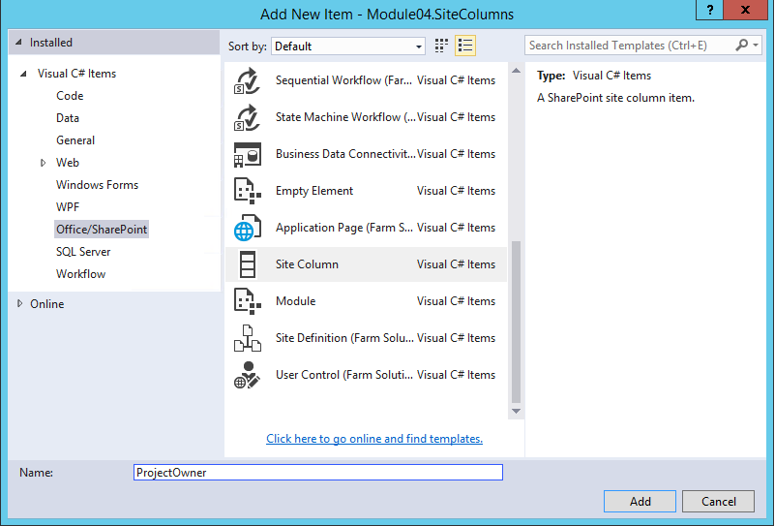
Working with Site Columns and List Columns
Site Column
Visual Studio
Add New Item
Choose Site Column
Provide a Name
Click Add

Slide 21
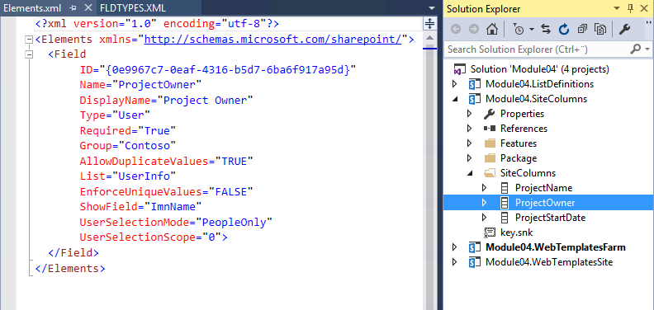
Working with Site Columns and List Columns
Site Column
Visual Studio
There is no designer for Site Columns so the next step is manually editing the XML markup.

Slide 22
Working with Site Columns and List Columns
SSOM – Create site column
using (var site = new SPSite("https://dev.contoso.local"))
{
var nameFieldDef = @"<Field ID='{2f554816-b79a-4853-b912-6b2a88789533}' Name='ProjectName'
DisplayName='Project Name' Type ='Text' Required='FALSE' Group='Contoso' />";
var ownerFieldDef = @"<Field ID='{0e9967c7-0eaf-4316-b5d7-6ba6f917a95d}' Name='ProjectOwner'
DisplayName='Project Owner‘ Type='User' Required='True' Group='Contoso' AllowDuplicateValues='TRUE'
List='UserInfo' EnforceUniqueValues='FALSE' ShowField='ImnName' UserSelectionMode='PeopleOnly'
UserSelectionScope='0' />";
var startFieldDef = @"<Field ID='{5a258f0a-bc3b-4cd4-a1c7-0639bd475fd4}' Name='ProjectStartDate'
DisplayName='Project Start Date' Type='DateTime' Required='FALSE' Group='Contoso' Format='DateOnly' />";
var web = site.RootWeb;
web.Fields.AddFieldAsXml(nameFieldDef, true, SPAddFieldOptions.AddFieldInternalNameHint);
web.Fields.AddFieldAsXml(ownerFieldDef, true, SPAddFieldOptions.AddFieldInternalNameHint);
web.Fields.AddFieldAsXml(startFieldDef, true, SPAddFieldOptions.AddFieldInternalNameHint);
}

Slide 23
Working with Site Columns and List Columns
CSOM – Create site column
using (var ctx = new ClientContext("https://dev.contoso.local/"))
{
var nameFieldDef = @"<Field ID='{2f554816-b79a-4853-b912-6b2a88789533}' Name='ProjectName'
DisplayName='Project Name' Type ='Text' Required='FALSE' Group='Contoso' />";
var ownerFieldDef = @"<Field ID='{0e9967c7-0eaf-4316-b5d7-6ba6f917a95d}' Name='ProjectOwner'
DisplayName='Project Owner' Type='User' Required='True' Group='Contoso' AllowDuplicateValues='TRUE'
List='UserInfo' EnforceUniqueValues='FALSE' ShowField='ImnName' UserSelectionMode='PeopleOnly'
UserSelectionScope='0' />";
var startFieldDef = @"<Field ID='{5a258f0a-bc3b-4cd4-a1c7-0639bd475fd4}' Name='ProjectStartDate'
DisplayName='Project Start Date' Type='DateTime' Required='FALSE' Group='Contoso' Format='DateOnly' />";
ctx.Web.Fields.AddFieldAsXml(nameFieldDef, true, AddFieldOptions.AddFieldInternalNameHint);
ctx.Web.Fields.AddFieldAsXml(ownerFieldDef, true, AddFieldOptions.AddFieldInternalNameHint);
ctx.Web.Fields.AddFieldAsXml(startFieldDef, true, AddFieldOptions.AddFieldInternalNameHint);
ctx.ExecuteQuery();
}

Slide 24
Working with Content Types
Introduced in SharePoint 2007 and used to define common business objects
SharePoint provides a large collection of content types out-of-the-box:
Document, Event, Task, Announcement, Page, etc.
Reuse existing content types or create custom
Locations:
C:\Program Files\Common Files\microsoft shared\Web Server Extensions\16\TEMPLATE\FEATURES\ctypes\
..\PublishingResources\
Content Types define the following:
Columns
Document Template
Information Management Policies
Workflow associations
Notes:
Similar to a class in object-oriented programming they provide state and behavior

Slide 25
Working with Content Types
Content types inherit from a parent similarly to a class in object-oriented programing
The system content type is at the root of the inheritance chain
Custom content types can inherit from item or below
If a content type is sealed it cannot be inherited from
Content type inheritance is governed by the content type ID
System
0x
Item
0x01
Document
0x0101
Task
0x0108
Custom
Custom
Custom
Custom
Notes:
https://support.office.com/en-us/article/introduction-to-content-types-and-content-type-publishing-a5026d23-8df8-42f6-b0d6-1920880c0d03

Slide 26
Working with Content Types
Content Type IDs
Item (inherits from System)
0x01
Contoso Project (inherits from Item)
0x016C17E9153F7948D5863393F20F296747
Document (inherits from Item)
0x0101
Contoso Document (inherits from Document)
0x0101F59F2FDA4D114E029097373DEFB4CACD
Notes:
https://docs.microsoft.com/en-us/previous-versions/office/developer/sharepoint-2010/aa543822(v%3Doffice.14)

Slide 27
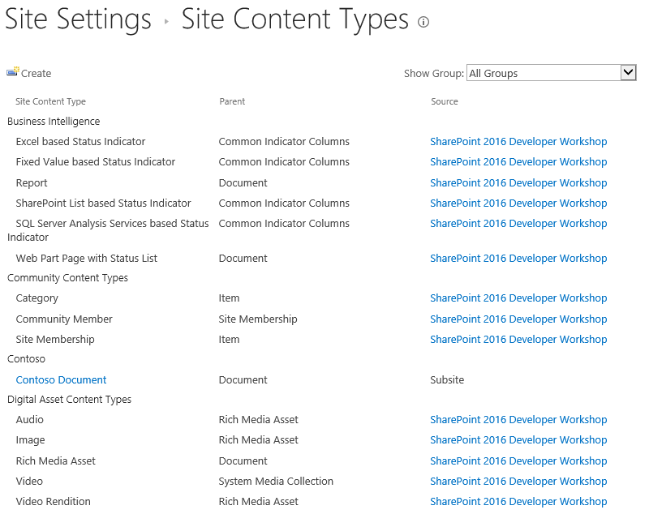
Working with Content Types
Content types can be created declaratively using features
Or programmatically using SSOM or CSOM
Created at either a Site or Site Collection level
As with site columns, a Site inherits content types defined by its parent
Inherited from parent site
Defined on this site

Slide 28
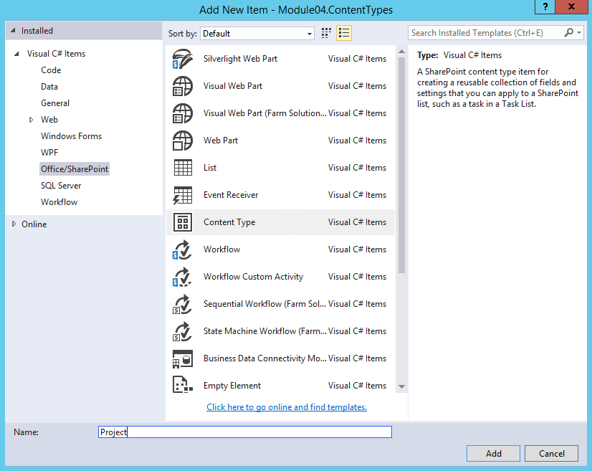
Working with Content Types
Visual Studio
Add New Item
Choose Content Type
Provide a Name
Click Add

Slide 29
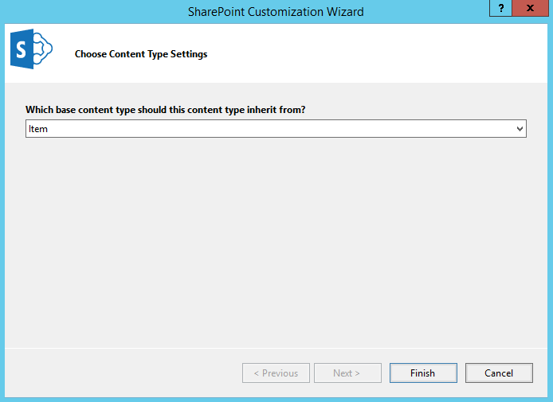
Working with Content Types
Content Type Wizard
Choose a parent content type
Click Finish

Slide 30
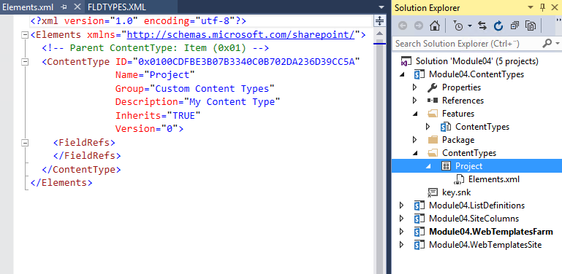
Working with Content Types
Content Type XML
There is a designer for ContentTypes to allow you to add columns to a content type or manually edit the Elements.xml file

Slide 31
Working with Content Types
SSOM – Create content type
using (var site = new SPSite("https://dev.contoso.local"))
{
var rootWeb = site.RootWeb;
var newCtId = new SPContentTypeId("0x0100CDFBE3B07B3340C0B702DA236D39CC5A");
var newCt = new SPContentType(newCtId, rootWeb.ContentTypes, "Project");
var newCtFields = newCt.FieldLinks;
rootWeb.ContentTypes.Add(newCt);
newCt.Group = "Contoso";
newCtFields.Add(new SPFieldLink(rootWeb.AvailableFields[new Guid("{2f554816-b79a-4853-b912-6b2a88789533}")]));
newCtFields.Add(new SPFieldLink(rootWeb.AvailableFields[new Guid("{0e9967c7-0eaf-4316-b5d7-6ba6f917a95d}")]));
newCtFields.Add(new SPFieldLink(rootWeb.AvailableFields[new Guid("{5a258f0a-bc3b-4cd4-a1c7-0639bd475fd4}")]));
newCt.Update(true);
}
Notes:
One must create the new CT without specific fields at first, then add the CT to the desired scope. Afterwards, add desired fields and then update the CT object.

Slide 32
Working with Content Types
CSOM – Create content type
using (var ctx = new ClientContext("https://dev.contoso.local"))
{
var web = ctx.Web;
var newCt = web.ContentTypes.Add(new ContentTypeCreationInformation() {
Name = "Project",
Id = "0x0100CDFBE3B07B3340C0B702DA236D39CC5A",
Group = "Contoso"
});
ctx.ExecuteQuery();
newCt.FieldLinks.Add(new FieldLinkCreationInformation { Field = web.Fields.GetById(new Guid("{2f554816-b79a-4853-b912-6b2a88789533}")) });
newCt.FieldLinks.Add(new FieldLinkCreationInformation { Field = web.Fields.GetById(new Guid("{0e9967c7-0eaf-4316-b5d7-6ba6f917a95d}")) });
newCt.FieldLinks.Add(new FieldLinkCreationInformation { Field = web.Fields.GetById(new Guid("{5a258f0a-bc3b-4cd4-a1c7-0639bd475fd4}")) });
newCt.Update(true);
ctx.ExecuteQuery();
}

Slide 33
Working with Content Types
SSOM – Create list and content type
using (var site = new SPSite("https://dev.contoso.local"))
{
var rootWeb = site.RootWeb;
var contentType = rootWeb.AvailableContentTypes[new SPContentTypeId("0x0100CDFBE3B07B3340C0B702DA236D39CC5A")];
var listId = rootWeb.Lists.Add("Project Directory", "List of projects", SPListTemplateType.GenericList);
var list = rootWeb.Lists.GetList(listId, false);
var defaultContentTypeId = list.ContentTypes.BestMatch(SPBuiltInContentTypeId.Item);
list.ContentTypesEnabled = true;
list.Update();
list.ContentTypes.Add(contentType);
list.ContentTypes.Delete(defaultContentTypeId);
}

Slide 34
Working with Content Types
CSOM – Create list and content type
using (var ctx = new ClientContext("https://dev.contoso.local/"))
{
var contentType = ctx.Web.AvailableContentTypes.GetById("0x0100CDFBE3B07B3340C0B702DA236D39CC5A");
var list = ctx.Web.Lists.Add(new ListCreationInformation() {
Title = "Project Directory",
Description = "List of projects",
TemplateType = (int)ListTemplateType.GenericList
});
ctx.Load(list.ContentTypes);
ctx.ExecuteQuery();
list.ContentTypesEnabled = true;
list.ContentTypes.AddExistingContentType(contentType);
list.ContentTypes.First().DeleteObject();
list.Update();
ctx.ExecuteQuery();
}

Slide 35
Working with Content Types
Content Type Syndication
Content types are defined at site collection or site level and can be reused across site collections either declaratively or programmatically
Reuse can be achieved without code using Content Type Syndication
Columns using published content types will also be syndicated
Requires configuration of a Content Type Hub
Site creation and feature activation
Enables the ability to publish, update and unpublish content types
Relies on two Timer Jobs in the background:
Content Type Hub
Content Type Subscriber
Configuration of Managed Metadata Service Application
Notes:
https://support.office.com/en-us/article/activate-a-content-type-syndication-hub-1d12ee7f-77e0-4b50-bf93-7628b8478bf6

Slide 36
Working with Taxonomy
Understanding Taxonomy features
SharePoint 2010 introduced the Managed Metadata Service Application (MMS)
Provides flexibility between taxonomy and folksonomy
It offers features to help implement an information architecture:
Hierarchical metadata
Enterprise Keywords
HashTags
Content Type Syndication
Notes:
More information:
https://docs.microsoft.com/en-us/sharepoint/managed-metadata

Slide 37
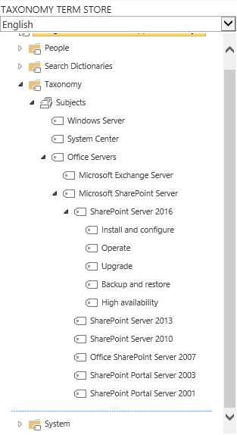
Working with Taxonomy
The Term Store is organized in a hierarchical manner
Term Store -> Term Group ->Term Set ->Term ->Term…
Only terms can be used as metadata values for site content
Term Sets can be defined at two scopes:
Globally (Term Store), Locally (Site Collection)
Columns can be configured to use all or subsets of terms in a Term Set
Ancestor Terms are implicitly applied to content
Built in support for Metadata Navigation on SharePoint Lists
Requires site feature Metadata Navigation and Filtering to be activated
Terms support multiple languages based on installed language packs
Notes:
More information:
https://docs.microsoft.com/en-us/sharepoint/create-and-manage-terms

Slide 38
Working with Taxonomy
SSOM – Create Term Group, Term Set and Terms
using (var site = new SPSite("https://dev.contoso.local"))
{
var taxSession = new TaxonomySession(site);
var termStore = taxSession.TermStores.First();
var group = termStore.CreateGroup("Global Taxonomy");
var termSet = group.CreateTermSet("Technology");
var rootTerm = termSet.CreateTerm("Microsoft", termStore.DefaultLanguage);
var firstTerm = rootTerm.CreateTerm("Office Servers", termStore.DefaultLanguage);
var secondTerm = firstTerm.CreateTerm("Microsoft SharePoint Server", termStore.DefaultLanguage);
termStore.CommitAll();
}
Notes:
This slide illustrates sample code which you can use to use the Server Side Object Model (SSOM) to create a term group, termset and three terms. Go through the code with your students to explain the syntax and how the lower levels depend on the higher levels to be created first.

Slide 39
Working with Taxonomy
CSOM – Create Term Group, Term Set and Terms
using (var ctx = new ClientContext("https://dev.contoso.local/"))
{
var taxSession = TaxonomySession.GetTaxonomySession(ctx);
ctx.Load(taxSession.TermStores, tstores => tstores.Include(ts => ts.DefaultLanguage));
ctx.ExecuteQuery();
var termStore = taxSession.TermStores.First();
var group = termStore.CreateGroup("Global Taxonomy", Guid.NewGuid());
var termSet = group.CreateTermSet("Technology", Guid.NewGuid(), termStore.DefaultLanguage);
var rootTerm = termSet.CreateTerm("Microsoft", termStore.DefaultLanguage, Guid.NewGuid());
var firstTerm = rootTerm.CreateTerm("Office Servers", termStore.DefaultLanguage, Guid.NewGuid());
var secondTerm = firstTerm.CreateTerm("Microsoft SharePoint Server", termStore.DefaultLanguage, Guid.NewGuid());
termStore.CommitAll();
ctx.ExecuteQuery();
}
Notes:
This code sample is to compare doing the same as on the previous slide with SSOM with the Client Side Object Model (CSOM). Highlight the differences in syntax compared to using SSOM.

Slide 40
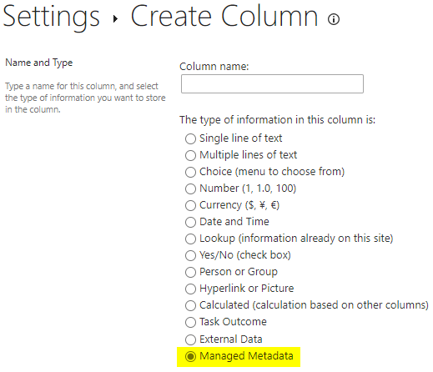
Working with Taxonomy
The Managed Metadata column
The Managed Metadata column is what connects content to the Taxonomy
SharePoint Server provides Field Types to support the creation of site columns and list columns
Notes:
Explain how you can make use of the Managed Metadata column type to add taxonomy data to lists.

Slide 41
Working with Taxonomy
SSOM – Create managed metadata site column
using (var site = new SPSite("https://dev.contoso.local"))
{
var taxSession = new TaxonomySession(site);
var termStore = taxSession.TermStores.First();
var termSet = taxSession.GetTermSets("Technology", (int)site.RootWeb.Language).FirstOrDefault();
var techFieldDef = "<Field DisplayName='Project Technology' Name='ProjectTechnology'
ID='{b55bedd3-4c38-41b5-8432-77e7fd6fd101}' Group='Contoso' Type='TaxonomyFieldType' />";
var fieldName = site.RootWeb.Fields.AddFieldAsXml(techFieldDef, false,
SPAddFieldOptions.AddFieldInternalNameHint);
var field = site.RootWeb.Fields.GetFieldByInternalName(fieldName) as TaxonomyField;
field.SspId = termSet.TermStore.Id;
field.TermSetId = termSet.Id;
field.Update();
}
Notes:
This sample shows adding a managed metadata field to a SharePoint list using the Server Side Object Model (SSOM)

Slide 42
Working with Taxonomy
CSOM – Create managed metadata site column
using (var ctx = new ClientContext("https://dev.contoso.local/"))
{
ctx.Load(ctx.Web, web => web.Language);
ctx.ExecuteQuery();
var taxSession = TaxonomySession.GetTaxonomySession(ctx);
var termSets = taxSession.GetTermSetsByName("Technology", (int)ctx.Web.Language);
ctx.Load(termSets, tSets => tSets.Include(t => t.Id), tSets => tSets.Include(t => t.TermStore));
ctx.ExecuteQuery();
var termSet = termSets.First();
var techFieldDef = "<Field DisplayName='Project Technology' Name='ProjectTechnology' ID='{b55bedd3-4c38-41b5-8432-77e7fd6fd101}'
Group='Contoso' Type='TaxonomyFieldType' />";
var field = ctx.Web.Fields.AddFieldAsXml(techFieldDef, false, AddFieldOptions.AddFieldInternalNameHint);
ctx.ExecuteQuery();
var taxField = ctx.CastTo<TaxonomyField>(field);
taxField.SspId = termSet.TermStore.Id;
taxField.TermSetId = termSet.Id;
taxField.Update();
ctx.ExecuteQuery();
}
Notes:
This sample shows adding a managed metadata field to a SharePoint list using the Client Side Object Model (CSOM)

Slide 43
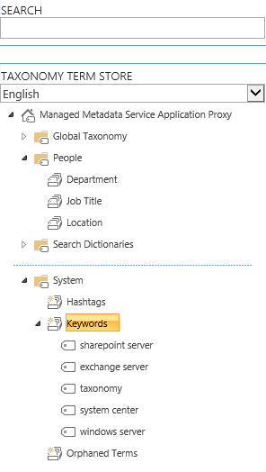
Working with Taxonomy
Enterprise Keywords column is created by default on all Site Collections
Combines terms from multiple scopes
Keywords Term Set
Any Term Set or Term marked as “Available for Tagging”
Keywords Term Set has an Open Submission Policy by default
Notes:
More information:
https://support.office.com/en-us/article/add-an-enterprise-keywords-column-to-a-list-or-library-314ce556-e4bf-4ef7-9939-6a1bedfc434a

Slide 44
Working with Taxonomy
SSOM – Add Enterprise Keyword column to list
using (var site = new SPSite("https://dev.contoso.local"))
{
var docLib = site.RootWeb.DefaultDocumentLibrary();
var docLibView = docLib.DefaultView;
var keywordField = site.RootWeb.AvailableFields.GetFieldByInternalName("TaxKeyword");
docLib.Fields.Add(keywordField);
docLibView.ViewFields.Add(keywordField.InternalName);
docLibView.Update();
}
Notes:
This sample shows adding an enterprise keyword field to a SharePoint list using the Server Side Object Model (SSOM)

Slide 45
Working with Taxonomy
CSOM – Add Enterprise Keyword to list
using (var ctx = new ClientContext("https://dev.contoso.local/"))
{
var docLib = ctx.Web.DefaultDocumentLibrary();
var docLibView = docLib.DefaultView;
var keywordField = ctx.Web.AvailableFields.GetByInternalNameOrTitle("TaxKeyword");
ctx.Load(keywordField, f => f.InternalName);
ctx.ExecuteQuery();
docLib.Fields.Add(keywordField);
docLibView.ViewFields.Add(keywordField.InternalName);
docLibView.Update();
ctx.ExecuteQuery();
}
Notes:
This sample shows adding an enterprise keyword field to a SharePoint list using the Client Side Object Model (CSOM)

Slide 46
Content Type Hub Syndication
Reuse content types over multiple site collections
One site collection functions as the hub
Other site collections can consume from the hub
Designate one or more content types to be published
Notes:
On SharePoint Online, a content type hub site collection is provisioned for you already at https://tenant.sharepoint.com/sites/contentTypeHub. It is not possible to create another one.
On SharePoint On-Premises you can designate any, but only one, site collection as the hub by enabling the site collection scoped feature named “Content Type Syndication Hub”. This will be demoed in detail on the next slide.
For more information:
https://support.office.com/en-us/article/activate-a-content-type-syndication-hub-in-sharepoint-server-versions-1d12ee7f-77e0-4b50-bf93-7628b8478bf6 https://support.office.com/en-us/article/publish-a-content-type-from-a-content-publishing-hub-58081155-118d-4e7a-9cc5-d43b5dbb7d02

Slide 47
Demo
Setting up Content Type Hub Syndication
Notes:
Designate the site collection at https://dev.contoso.local as the content type hub
Go to https://dev.contoso.local
Go to Site Settings
Under “Site Collection Administration” go to “Site collection features”
Activate the feature “Content Type Syndication Hub”
Go to Central Administration
Under “Application Management” go to “Manage service applications”
Click on the line with “Managed Metadata Service Application” (not the proxy), but don’t click on the text itself, so you’ll stay on the page with all the service applications
Click on Properties in the ribbon at the top
Scroll all the way down in the “Create New Managed Metadata Service” dialog until you see “Content Type hub”. In that field, enter: https://dev.contoso.local
Click OK to close the dialog
Now click on the line that reads “Managed Metadata Service Application Proxy” which is a little indented without clicking on the text and click on Properties in the ribbon at the top.
Ensure the boxes are checked in front of the bottom two options “Consumes content types from the Content Type Gallery at https://dev.contoso.local/.” and “Push-down Content Type Publishing updates from the Content Type Gallery to sub-sites and lists using the content type.”
Click OK to close the dialog
Create a content type to publish
Go back to https://dev.contoso.local
Go into the Site Settings
Go into “Site content types” under “Web Designer Galleries”
Create a new content type of whichever type you want
Once the content type has been created, being on the details page of the content type (ManageContentType.aspx), click on the link “Manage publishing for this content type”
Explain the various options on this screen
Ensure “Publish” is selected, which is likely the only available option anyway, and click OK
Go back into the “Manage publishing for this content type” link and validate that it now shows a date and time at “Last successful published date”. This means the content type is now available for other site collections to consume.
Configure another site to consume the content type
Go to https://team.contoso.local
Go to Site Settings
Go to “Content type publishing” under “Site Collection Administration”
Check the box for “Refresh all published content types on next update”
Click OK
Trigger the SharePoint Timer Jobs for content type distribution manually to avoid a wait
Go to Central Administration
Under “Monitoring” go to “Check job status”
On the left click on “Job Definitions”
Look for and click on the “Content Type Subscriber”
Click on “Run Now” at the bottom
Look for and click on the “Content Type Hub”
Click on “Run Now” at the bottom
Validate that the content type you have syndicated from the hub is now available
Go back to https://team.contoso.local
Go to Site settings
Under “Site Collection Administration” click on “Content type publishing”
At the “Hubs” section, it should now show you the content type you have created and published earlier in this demo. If not, it’s probably not worth the time to troubleshoot this. Just mention that it could take a little longer to propagate, but that once it’s done, it will show up here and stop this demo.
If it does show your entry at “Hubs”, go to Site settings again
Under “Web Designer Galleries” go to “Site content types”
You should be able to find your content type in the list now, click on it
Notice how you have very limited options in this content type now, as it is defined from the content type hub level and pushed down to all subscribing sites

Slide 48
Knowledge Check
At what scope can content types and columns be created?
What are the requirements for Content Type Syndication?
Site Collection (SPSite)
Columns
A Site Collection to serve as Content Type Hub is created
Site (SPWeb)
Cross Site Collection (through Content Type Hub Syndication)
What can be defined on a content type?
Document Template
Workflow
Information Management Policies
The Content Type Hub feature is activated on the Site Collection
The Service Application Proxy is configured with the URL to the Content Type Hub

Slide 49
Lesson Summary
Field Types
Site Columns and List Columns
Content Types
Taxonomy

Slide 50
Questions?

